Slide 1


Slide 2

Using Google Assistant to Initiate Infrastructure Automation
Introducing automation to infrastructure completely changes how existing engineers interact with ever growing footprints. By making automation easier to consume it greatly increases adoption rates. Also moving workflow initiation from a manual task by an engineer to an automated task initiated by the customer you’re able to free up cycles and increase customer experience. An example would be a service desk agent asking the google assistant to change a vlan on a user interface. By pushing this down to the service desk the request is able to be completed while the user is still commuting with the agent and does not require a ticket to be sent to an operations engineer to be worked.

Slide 3
Introduction
Sr Network Automation Consultant
Primarily work with Python and Ansible
Developed chat integrations for Fortune 500 companies

Slide 4
Network to Code
Founded in 2014 by Jason Edelman
Based in Manhattan
Services company with a focus in Network Automation
Offers consulting, professional and educational services
~30 global employees

Slide 5

Benefits
Decrease mean time to resolution
Ability to expose automation closer to the consumer
Empower end users
Ability to quickly data

Slide 6
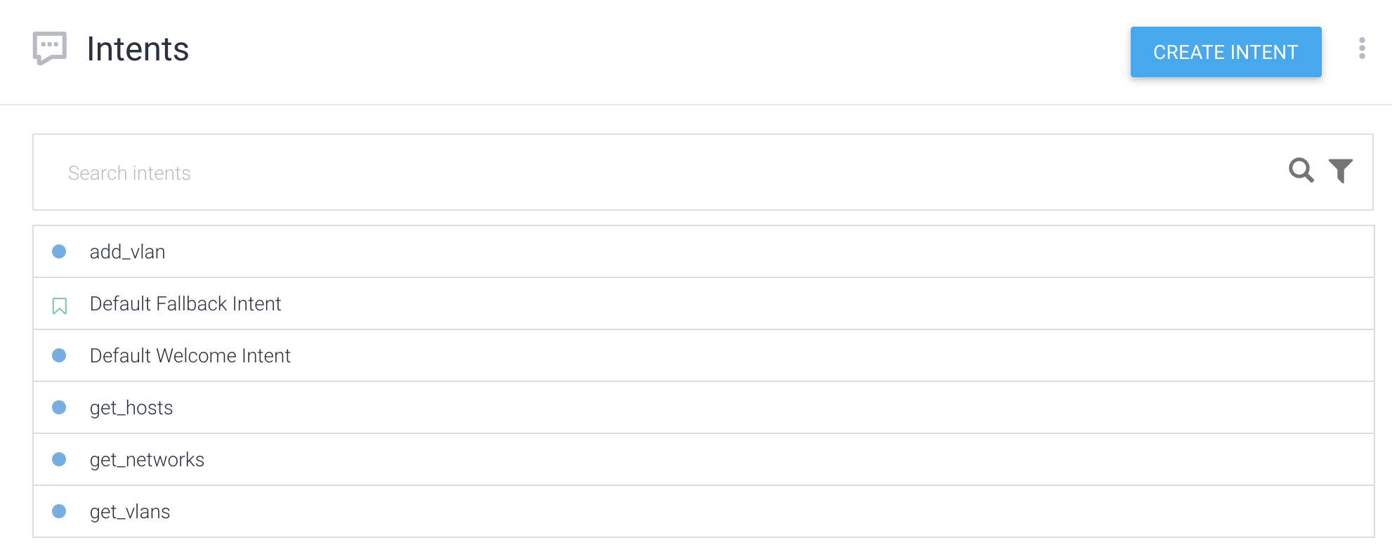
Intents

Slide 7
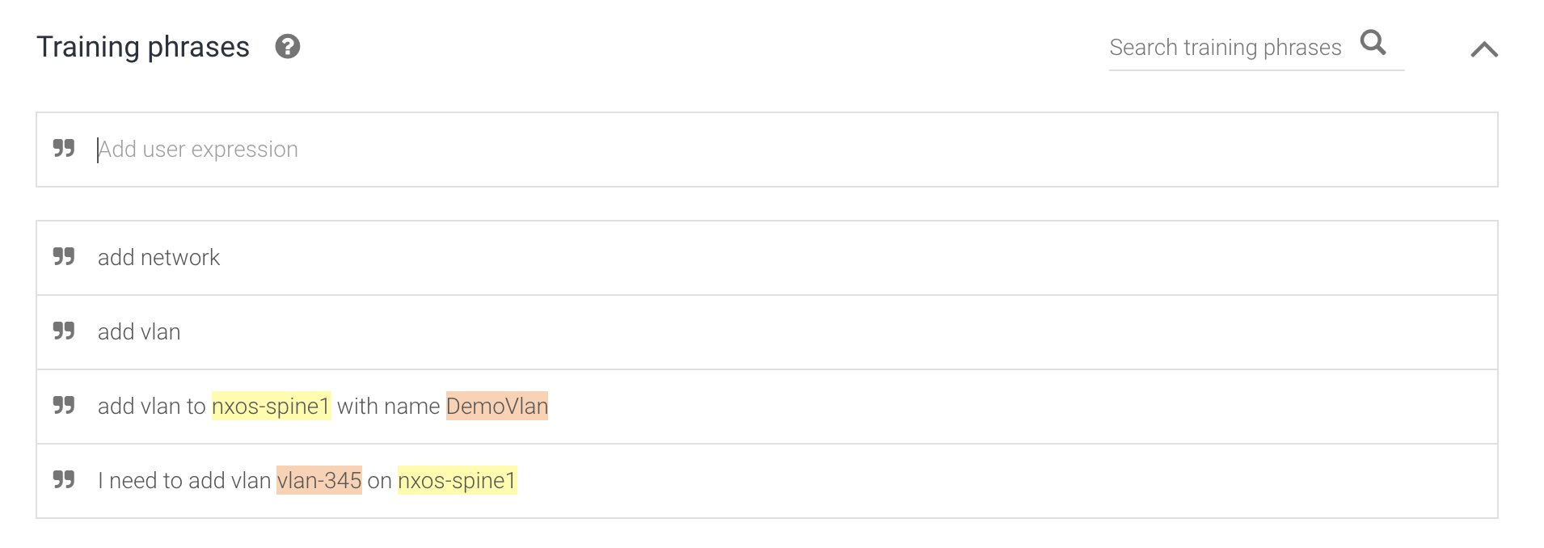
Intents

Slide 8
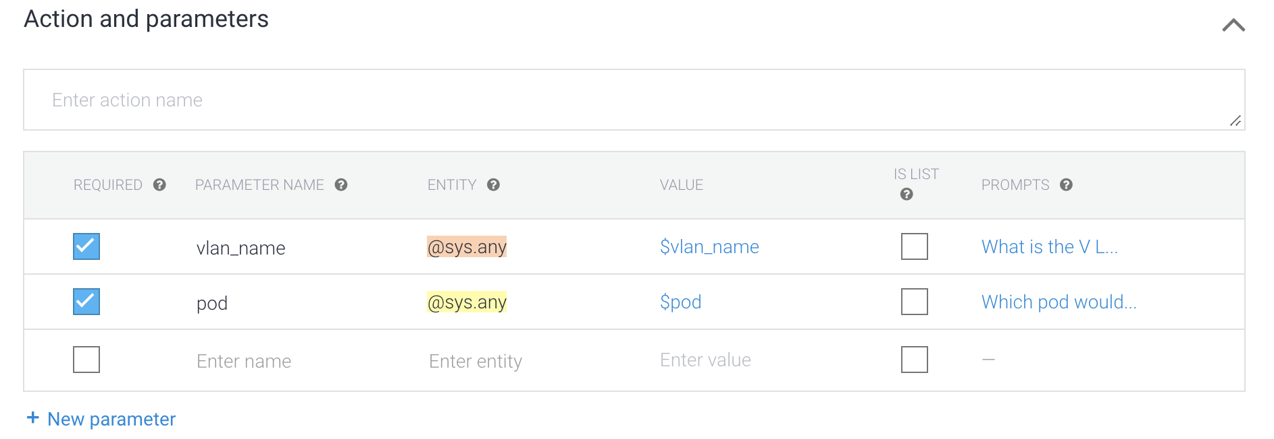
Intents

Slide 9

Intents

Slide 10
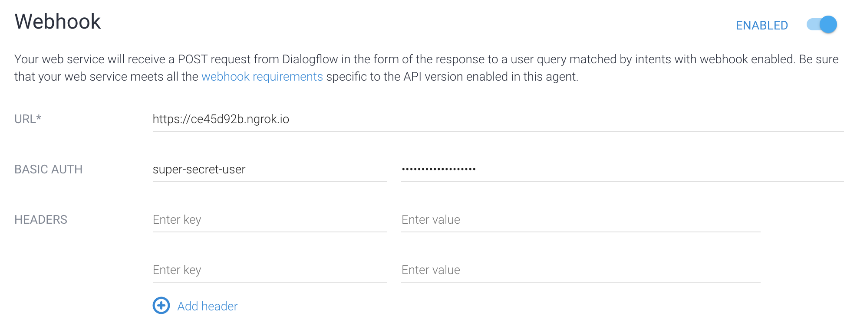
Fulfillment

Slide 11

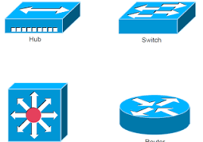




Architecture
SoT

Slide 12
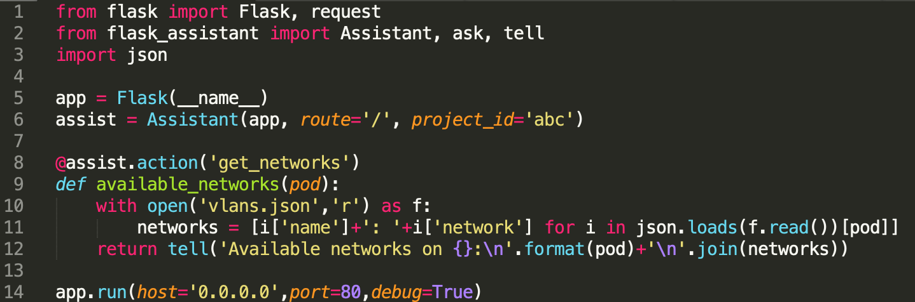
Sample Code

Slide 13

Demo
Request for VLANs to match pods

